Slide 1








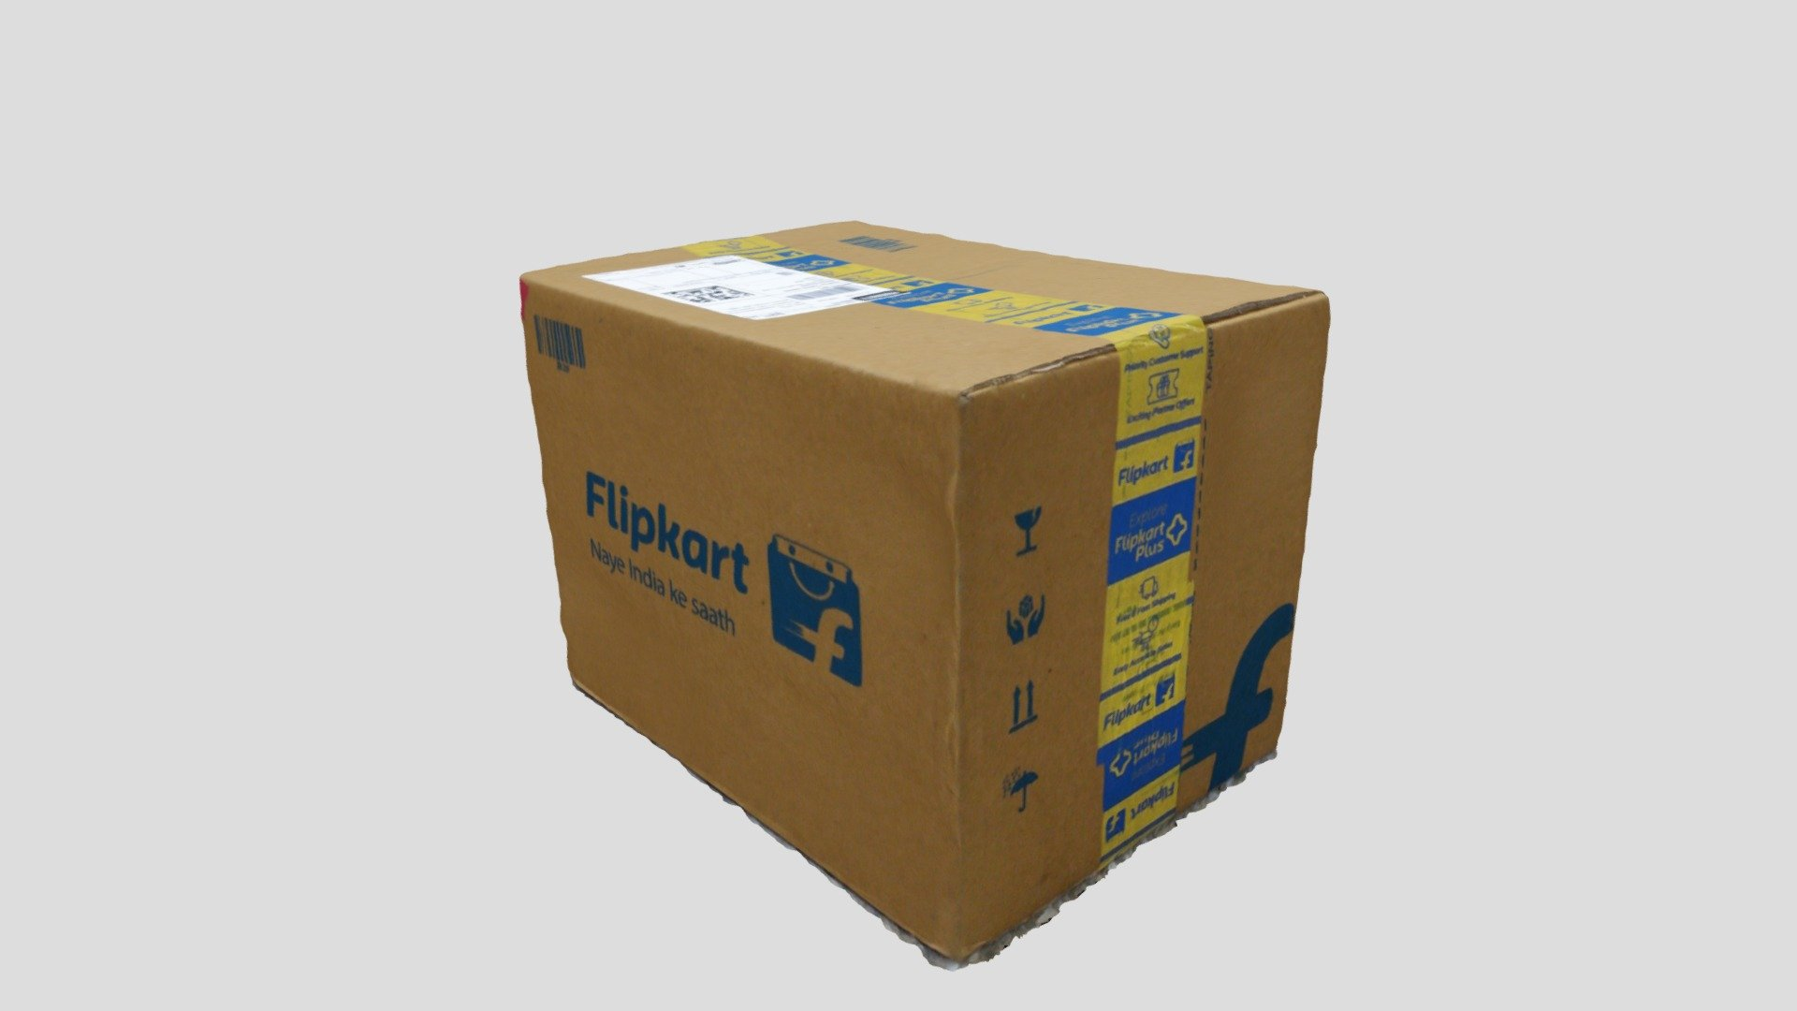
MY SQL
PROJECT
LOGISTICS OPTIMIZATION FOR
DELIVERY ROUTES-FLIPKART

Slide 2

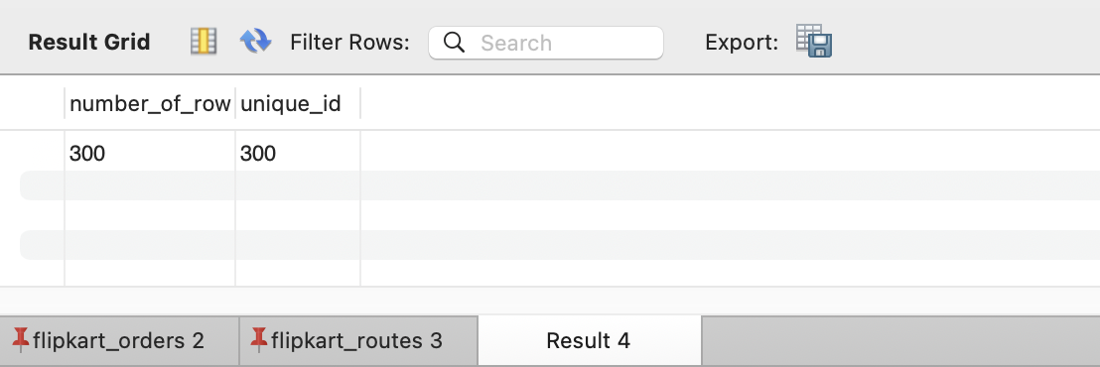
Task1.1→ Identify and delete duplicate Order ID record

Slide 3
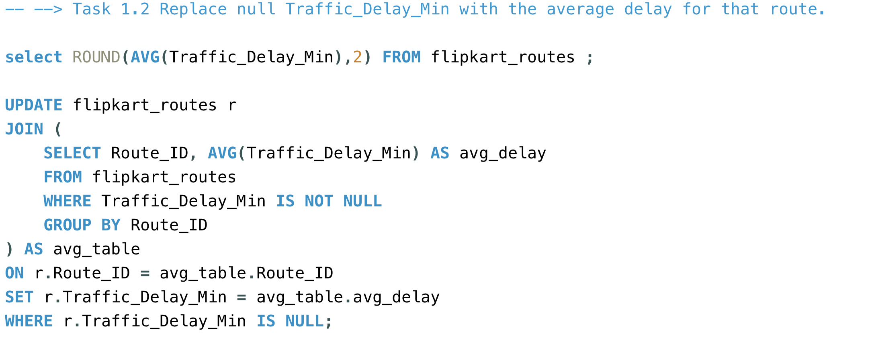
Task1.2→ Replace null Traffic Delay Min with the average delay for that route

Slide 4
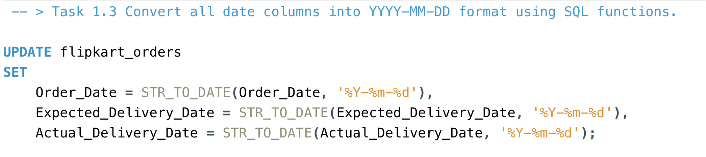
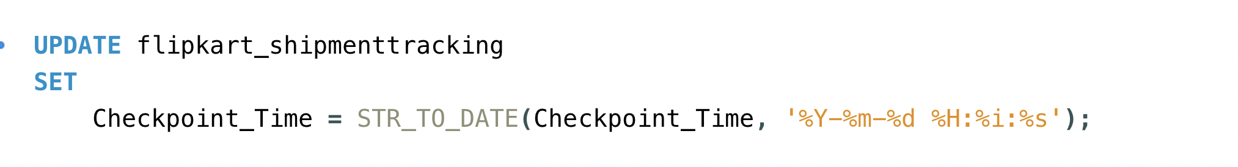
Task1.3→ Convert all date columns into YYYY-MM-DD format using SQL functions

Slide 5
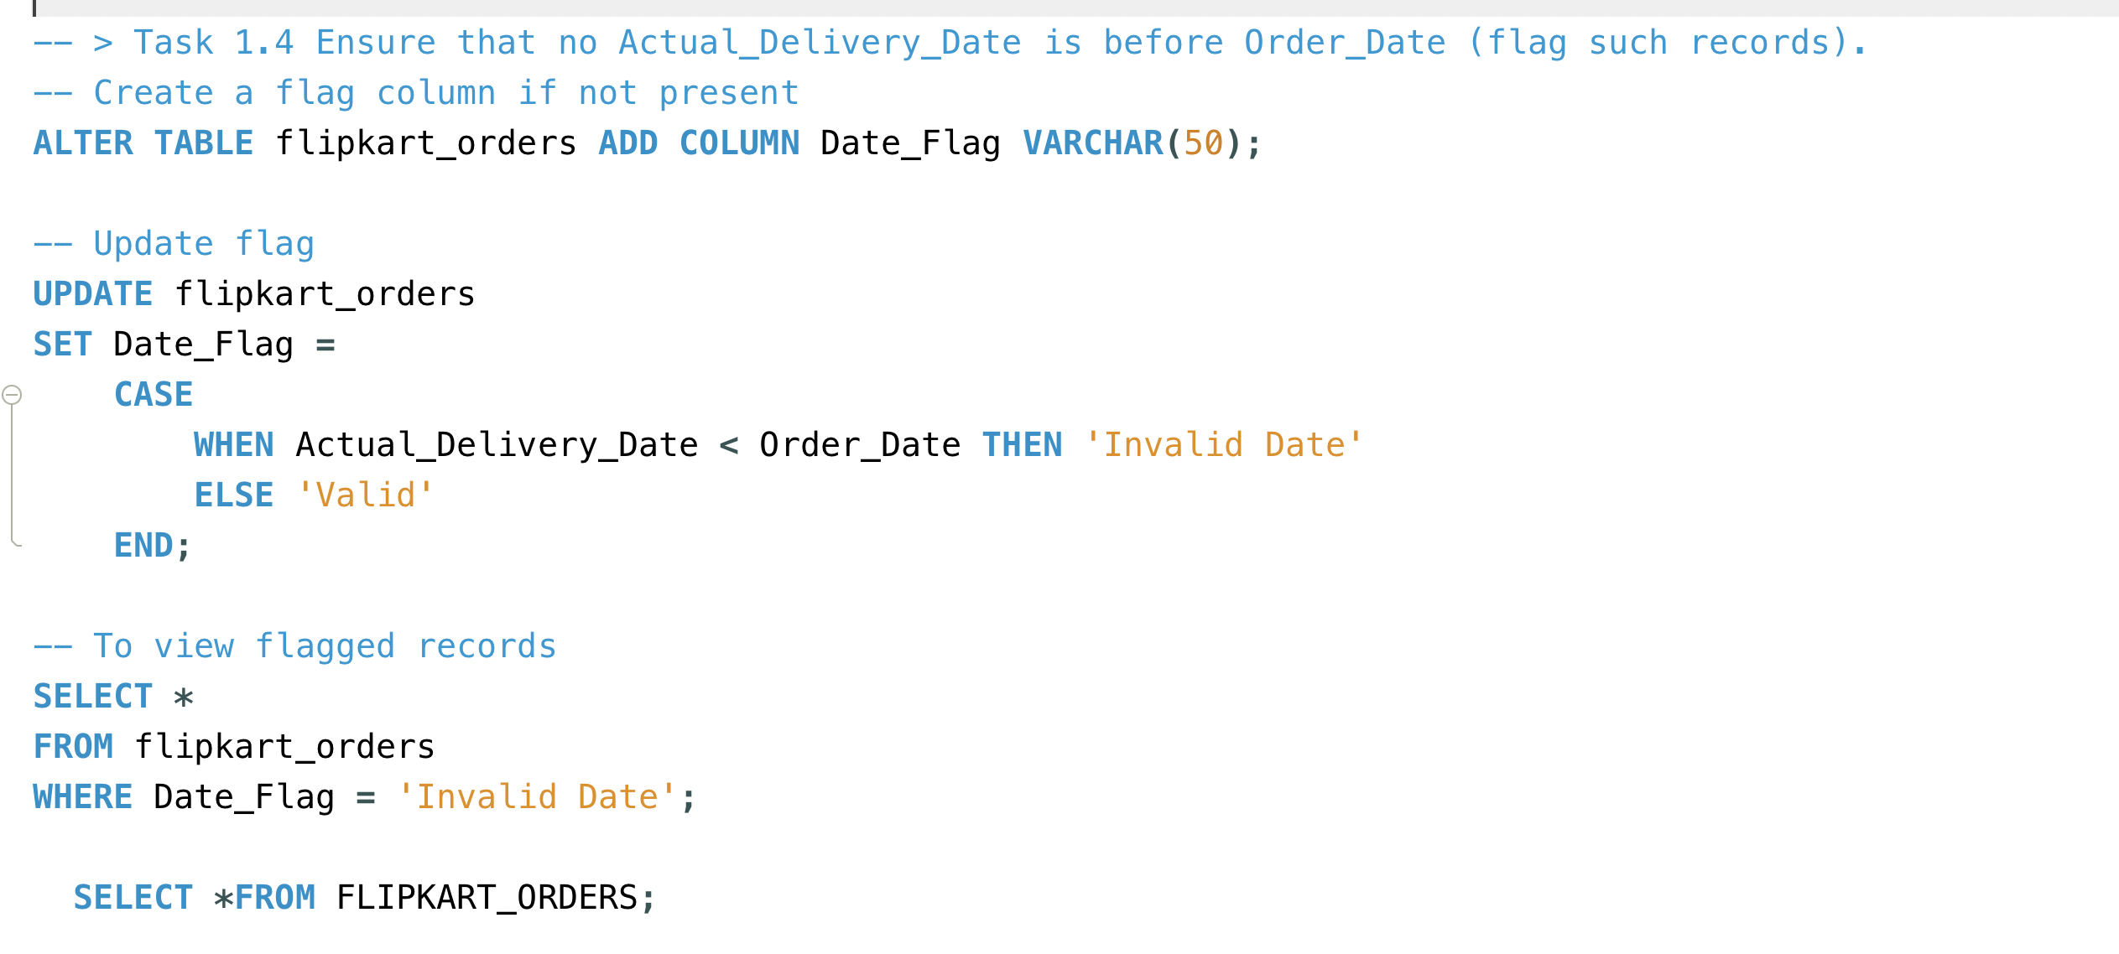
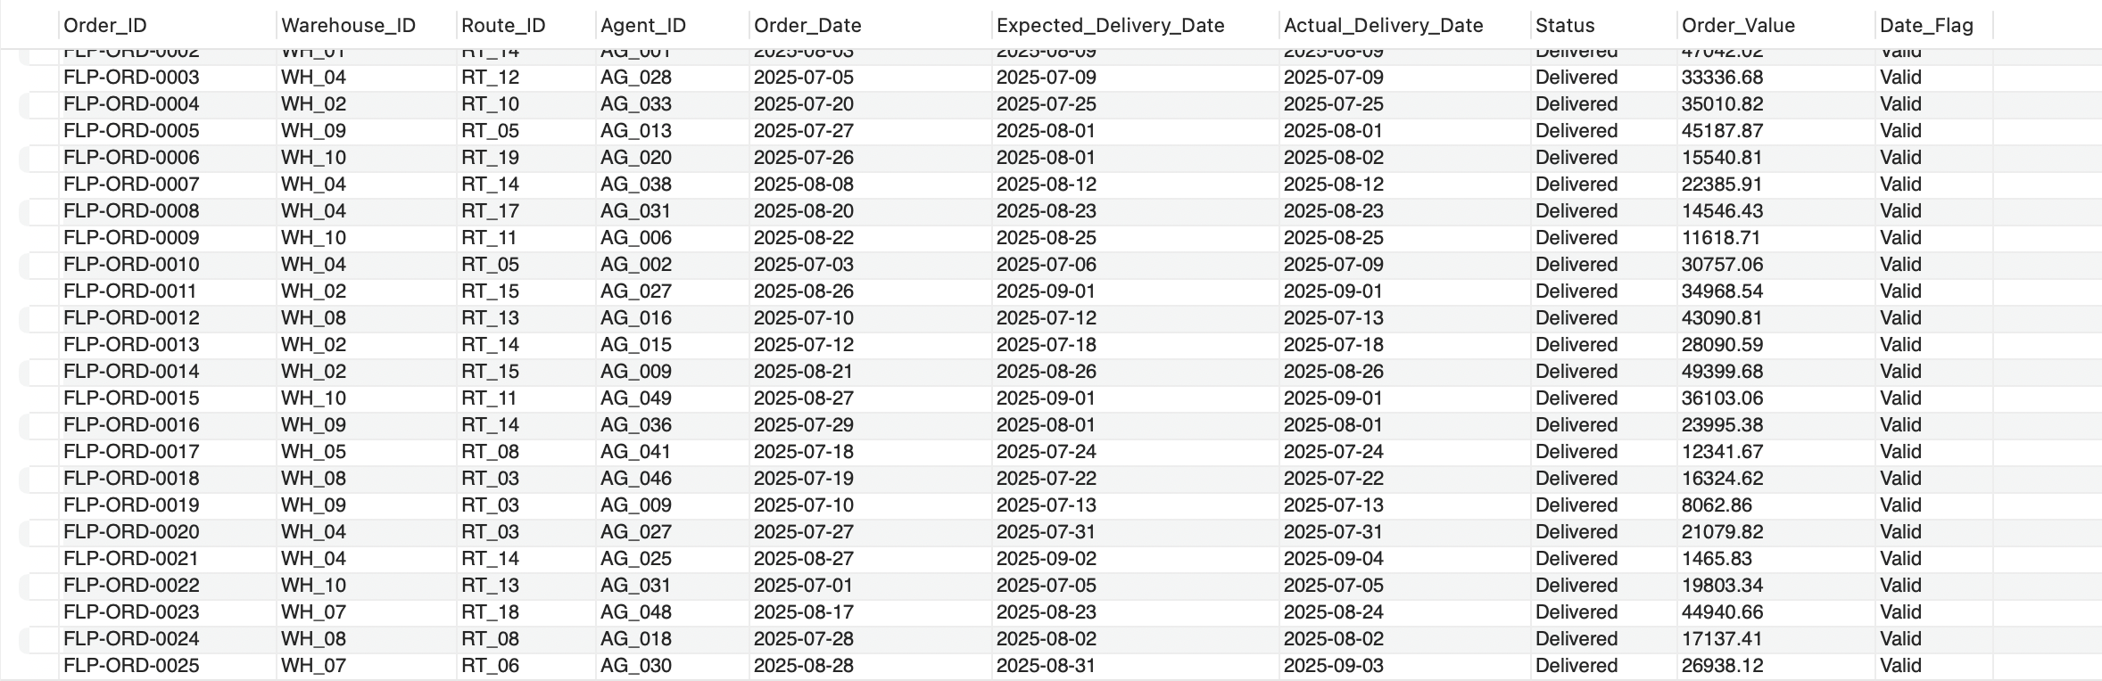
Task1.4→Ensure that no Actual Delivery Date is before Order Date (flag such records).

Slide 6
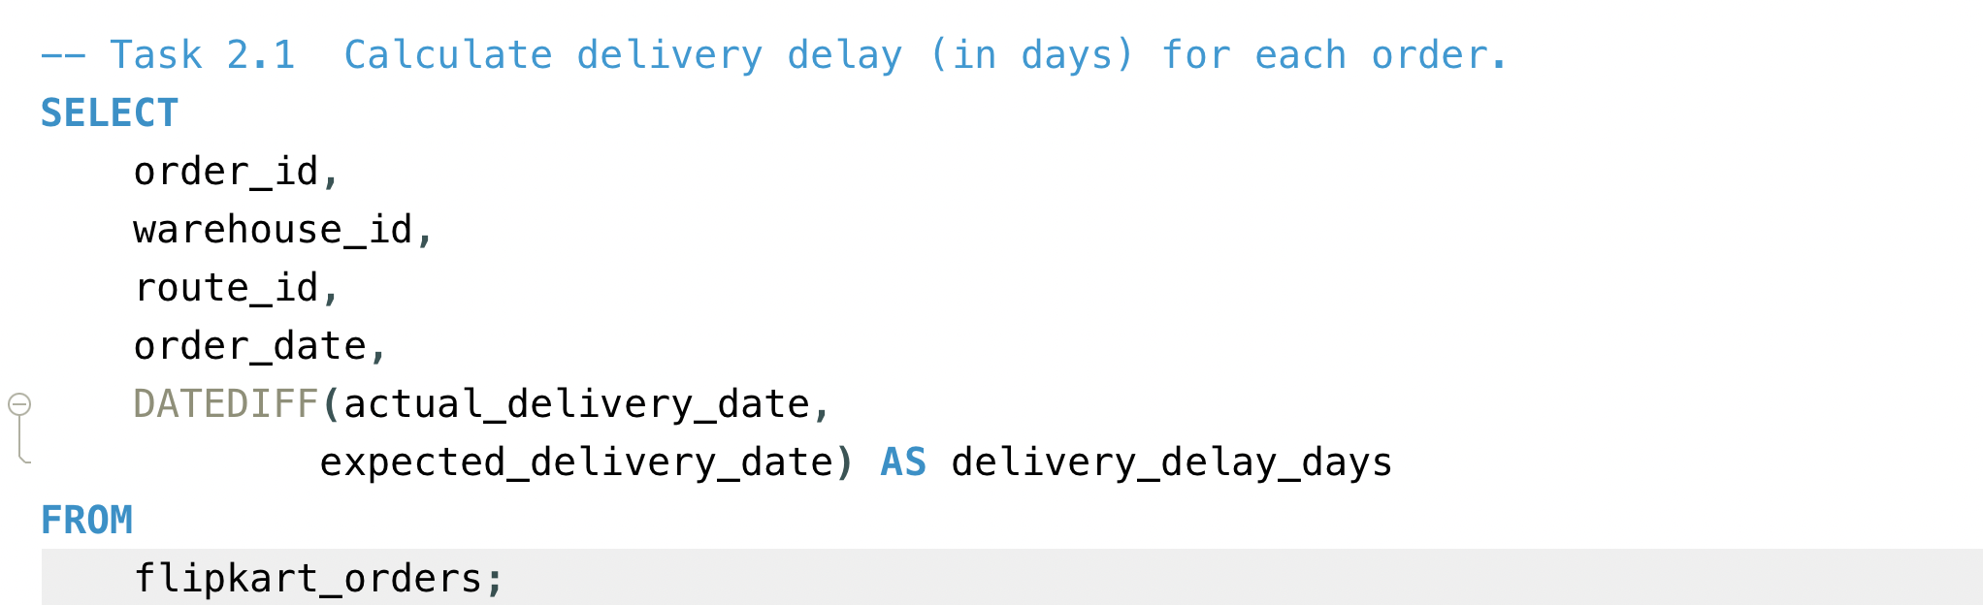
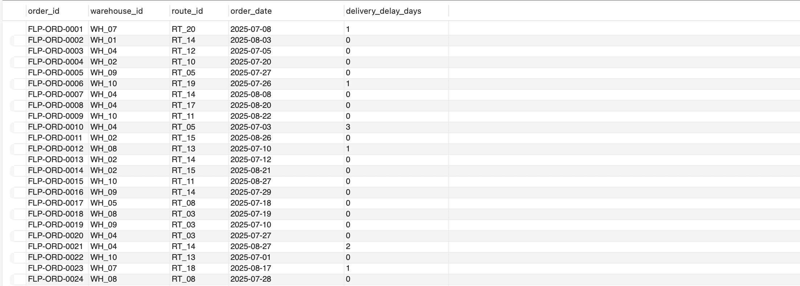
Task 2.1→ Calculate delivery delay (in days) for each order

Slide 7
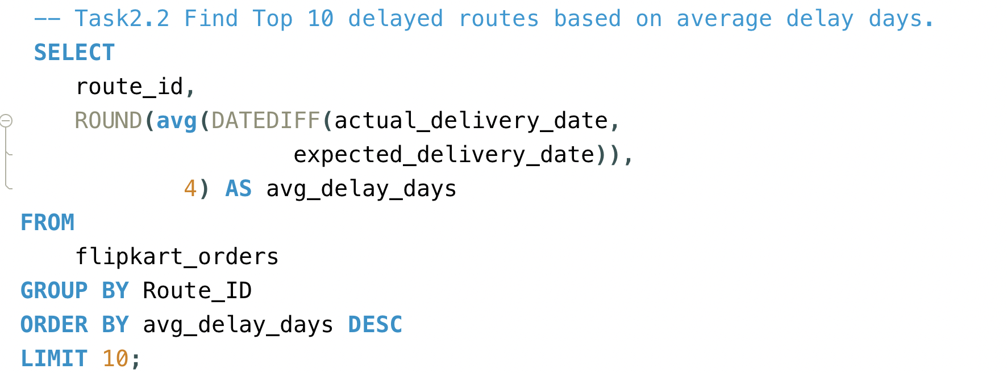
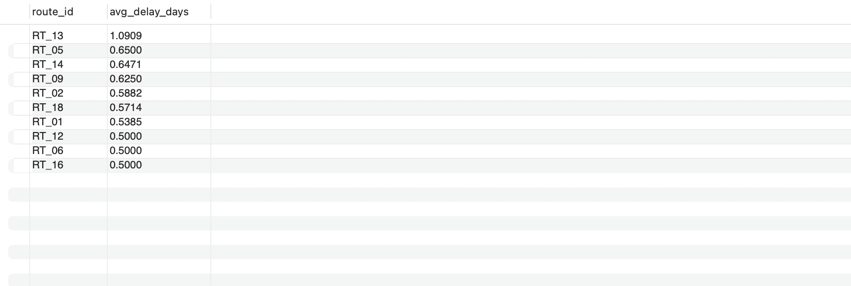
Task 2.2→Find Top 10 delayed routes based on average delay days.

Slide 8
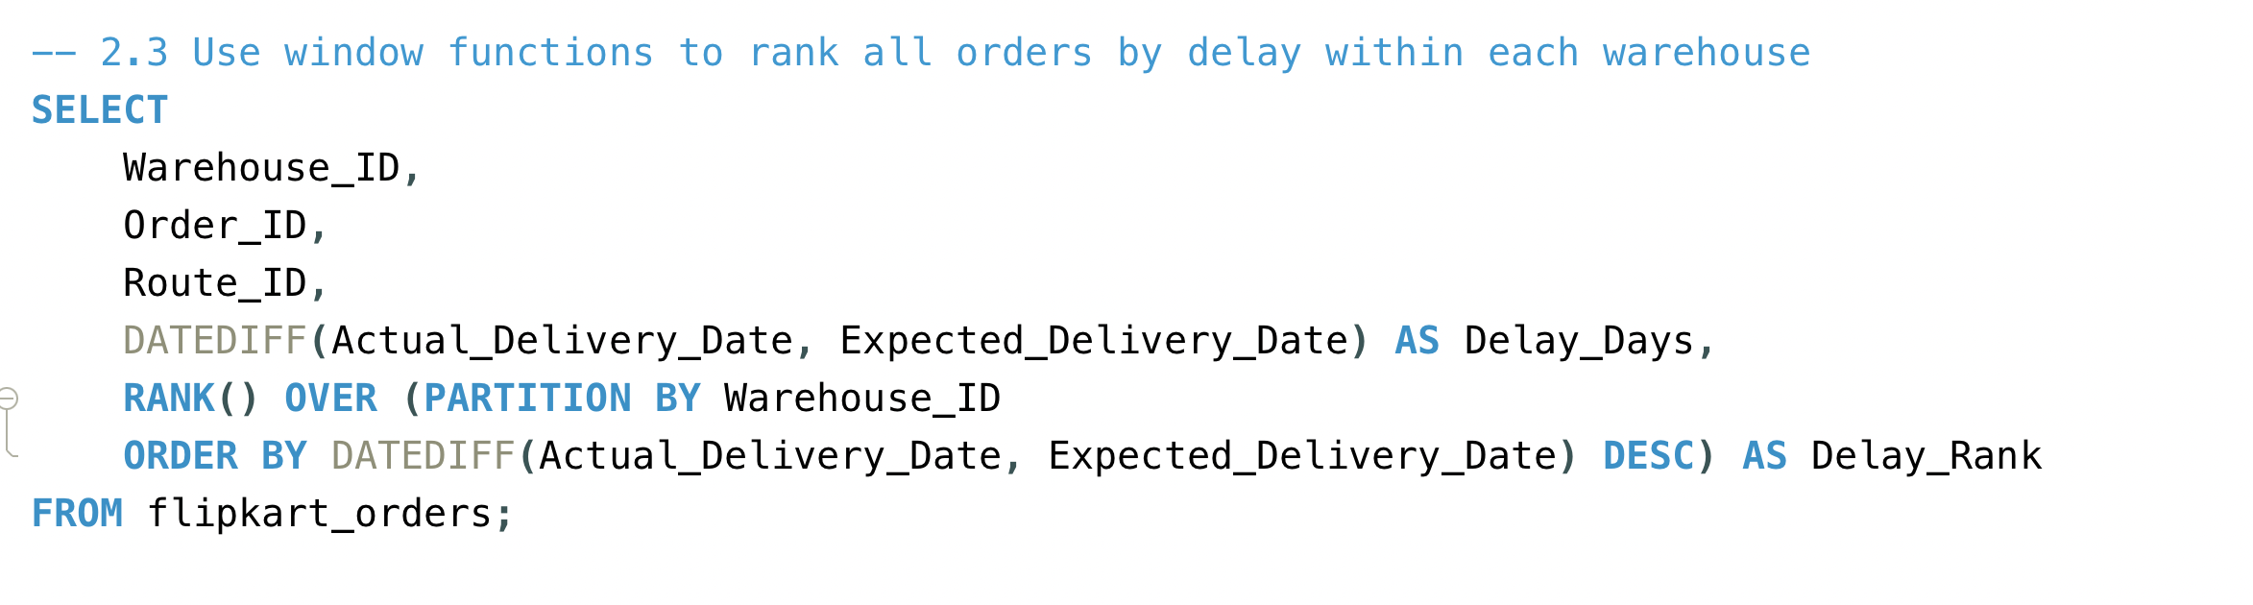
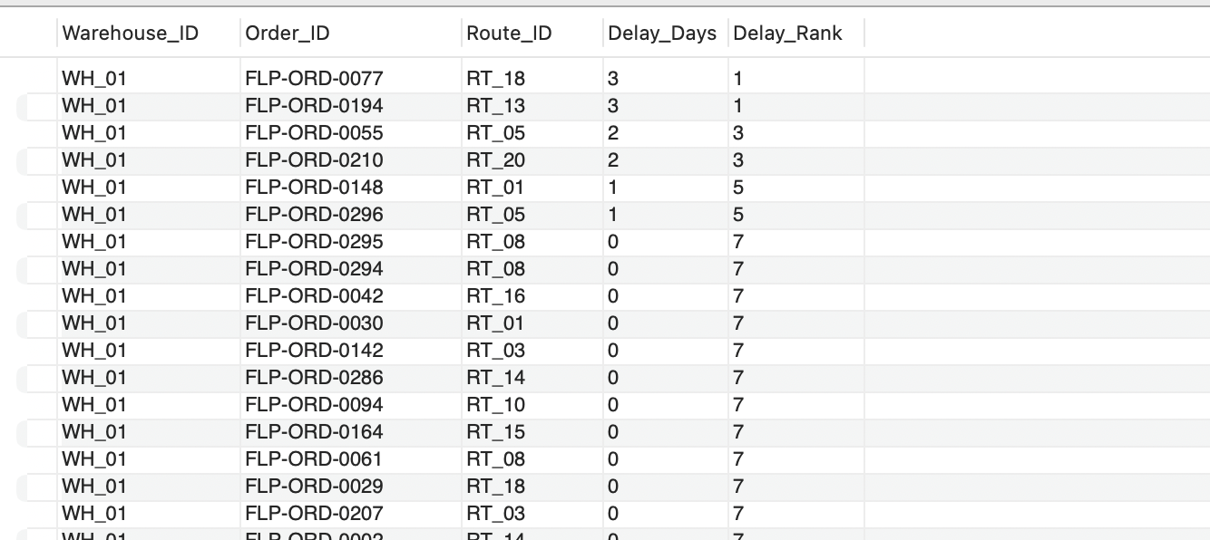
Task 2.3→ Use window functions to rank all orders by delay within each warehouse

Slide 9
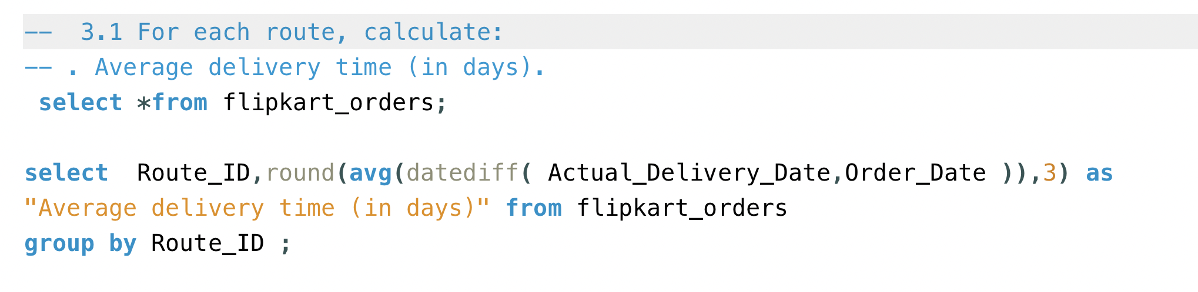
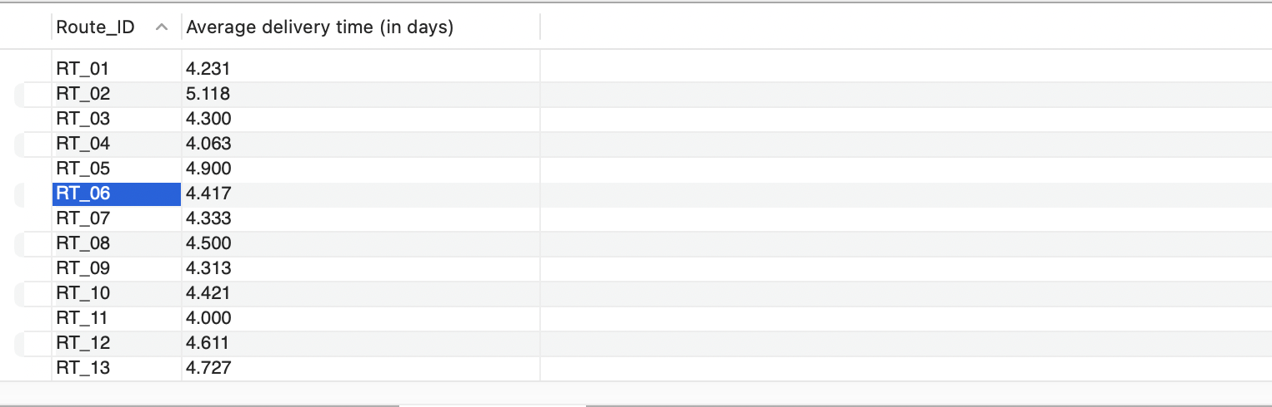
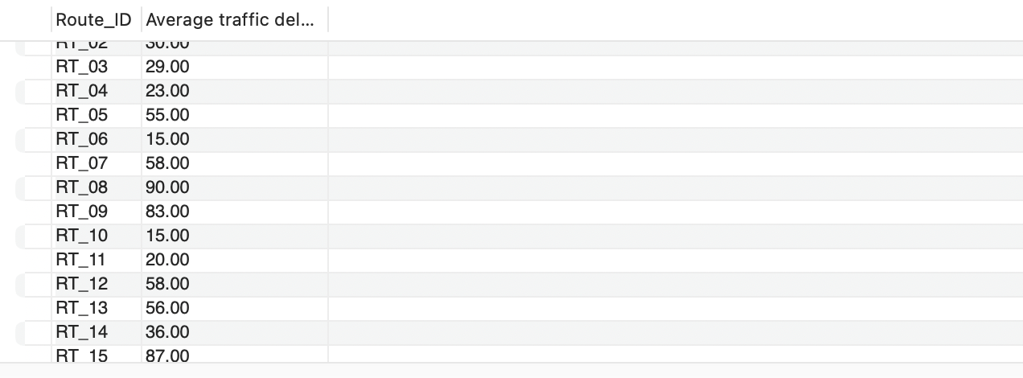
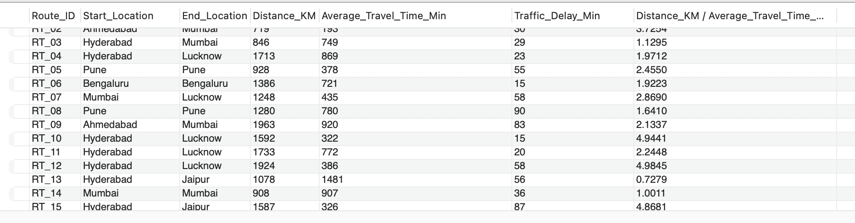
Task
3.1 For each route, calculate:
○ Average delivery time (in days).
○ Average traffic delay.
○ Distance-to-time efficiency ratio: Distance KM / Average Travel Time Min
Task

Slide 10
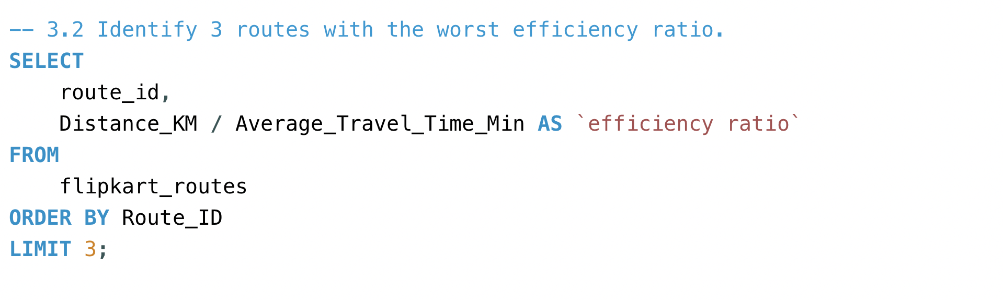
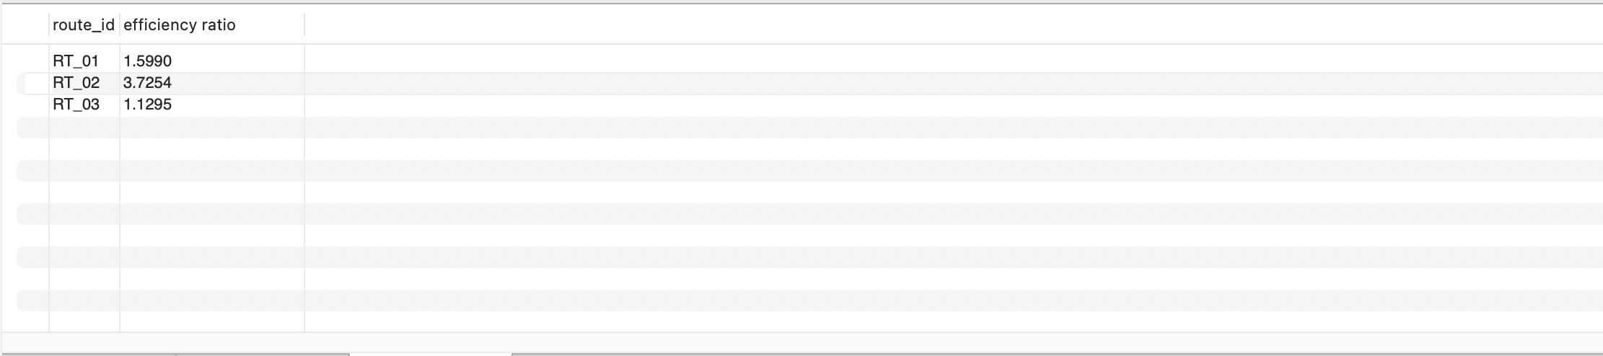
Task 3.2→ Identify 3 routes with the worst efficiency ratio

Slide 11
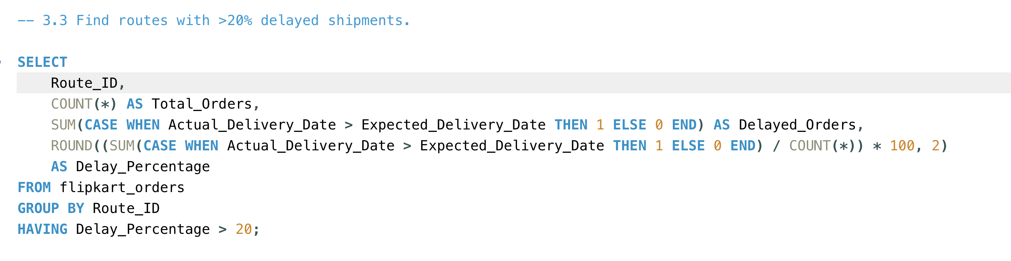
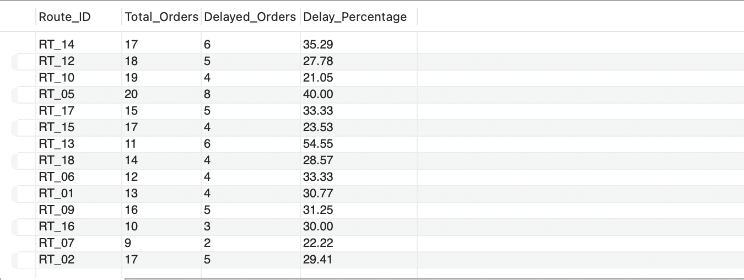
Task 3.3→ Find routes with >20% delayed shipments

Slide 12
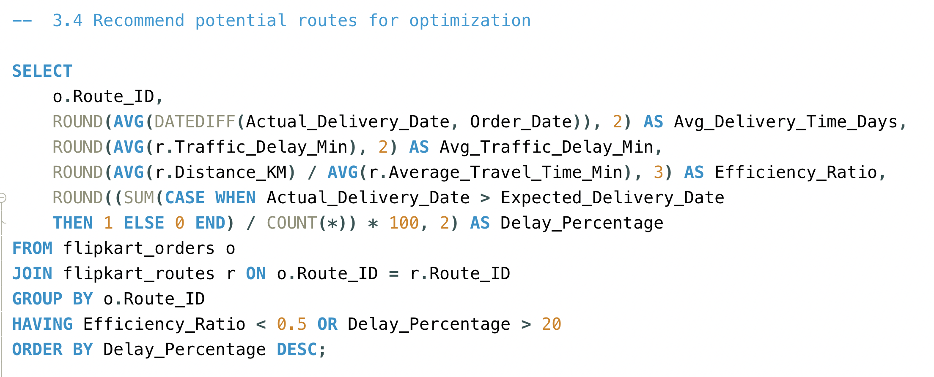
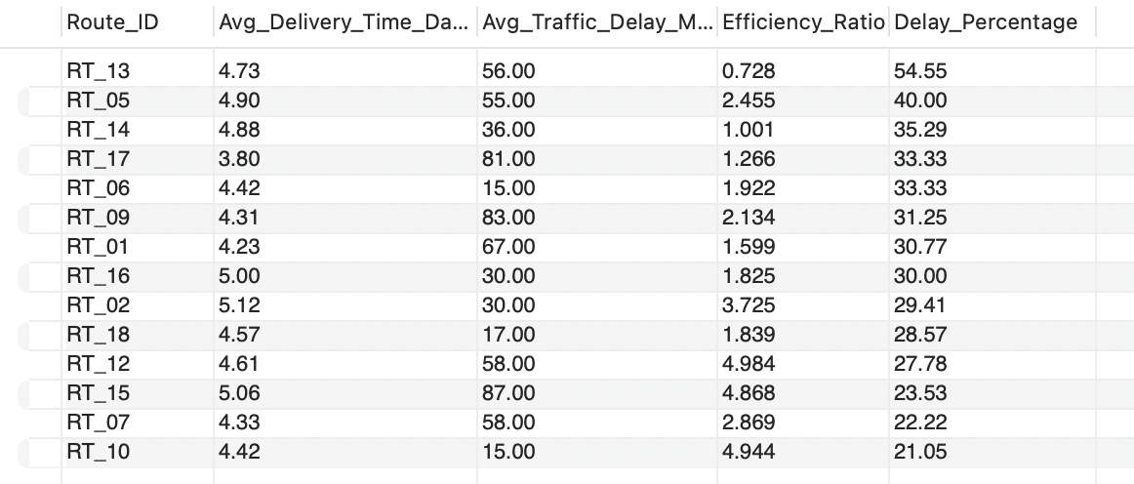
Task 3.4→ Recommend potential routes for optimization

Slide 13
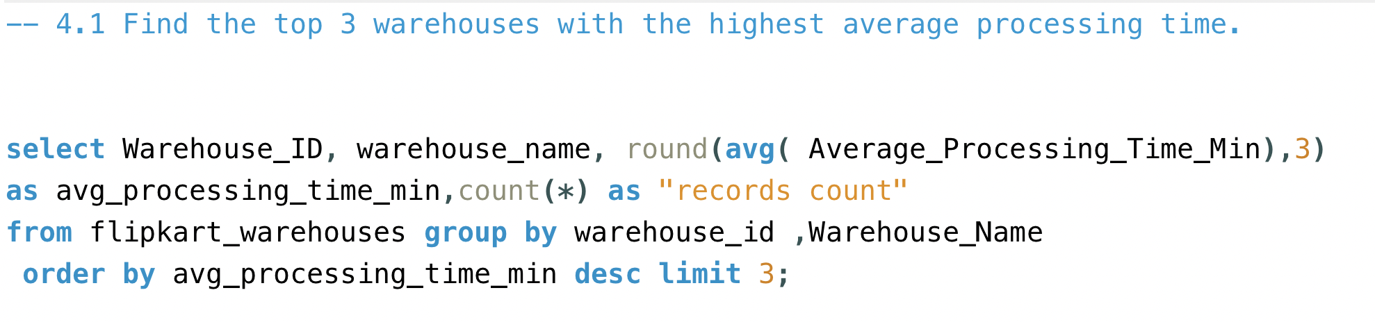
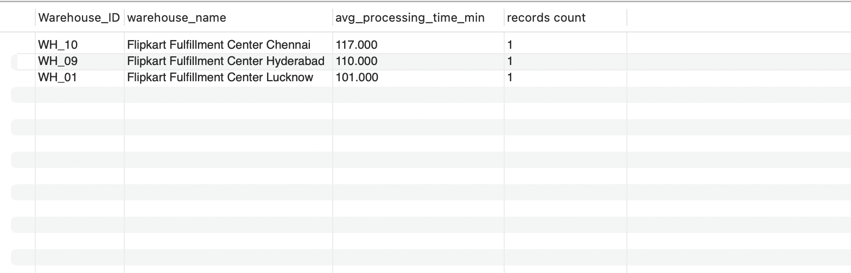
Task 4.1→ Find the top 3 warehouses with the highest average processing time.

Slide 14
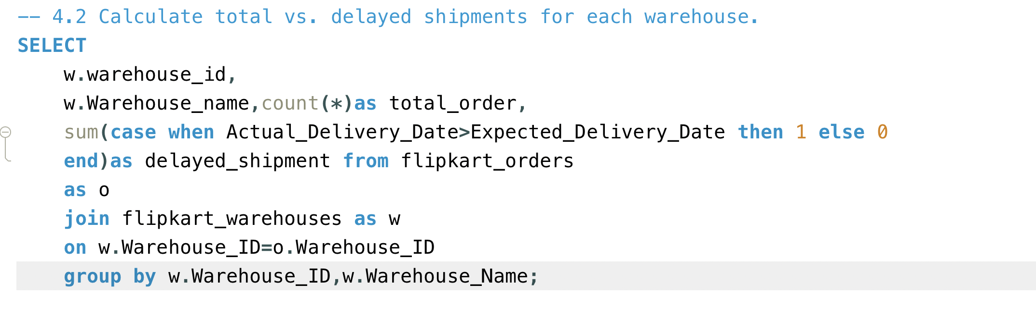
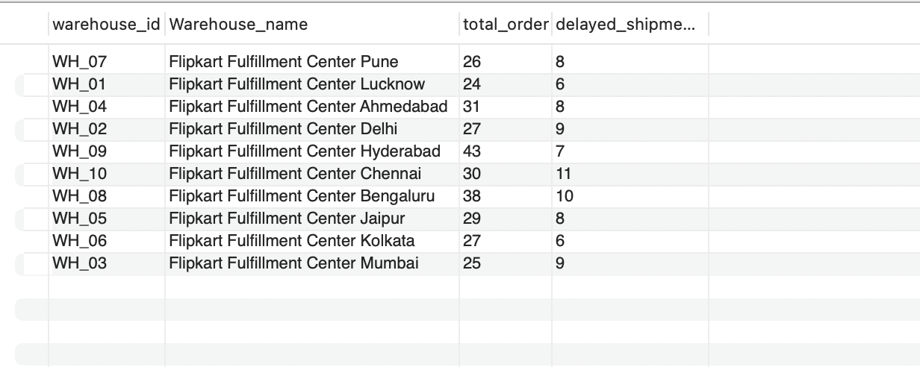
Task 4.2→ Calculate total vs. delayed shipments for each warehouse.

Slide 15
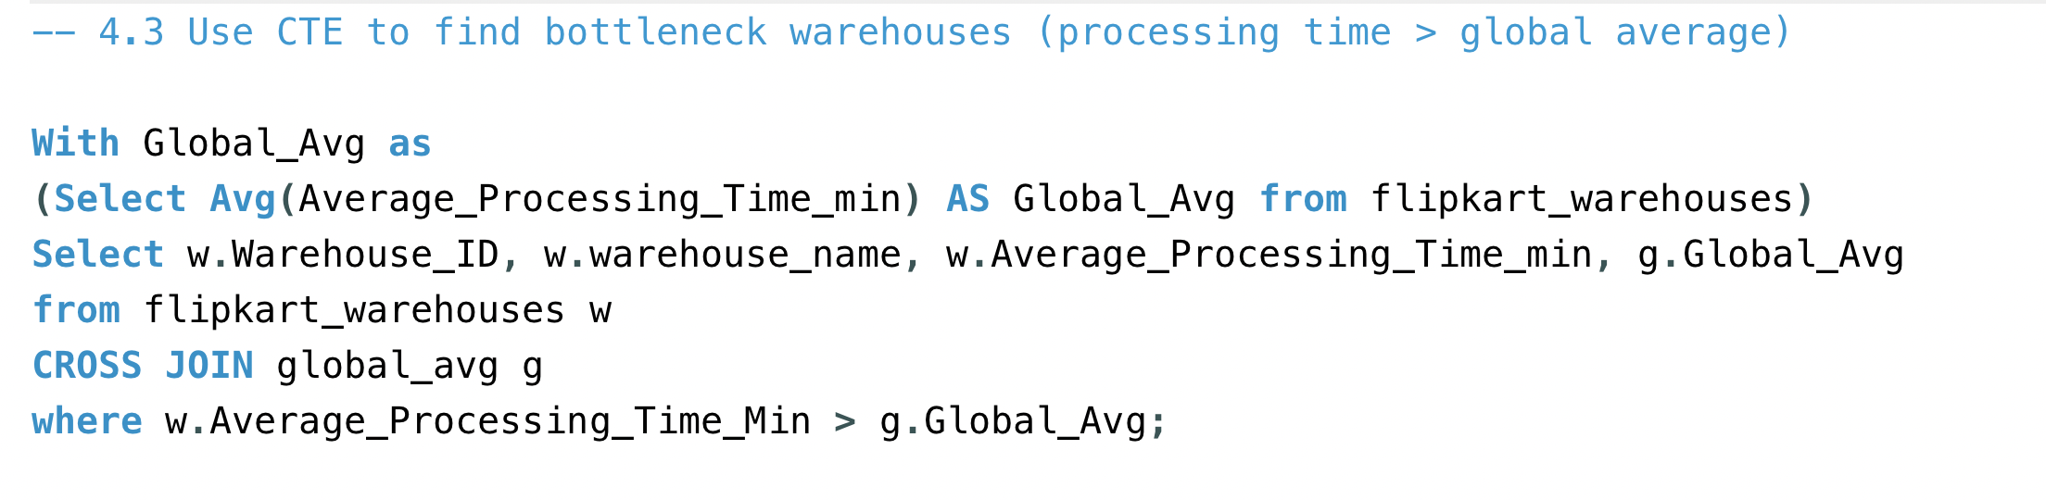
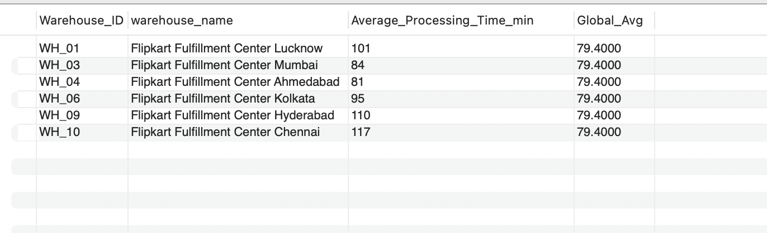
Task 4.3→ Use CTEs to find bottleneck warehouses where processing time > global average.

Slide 16
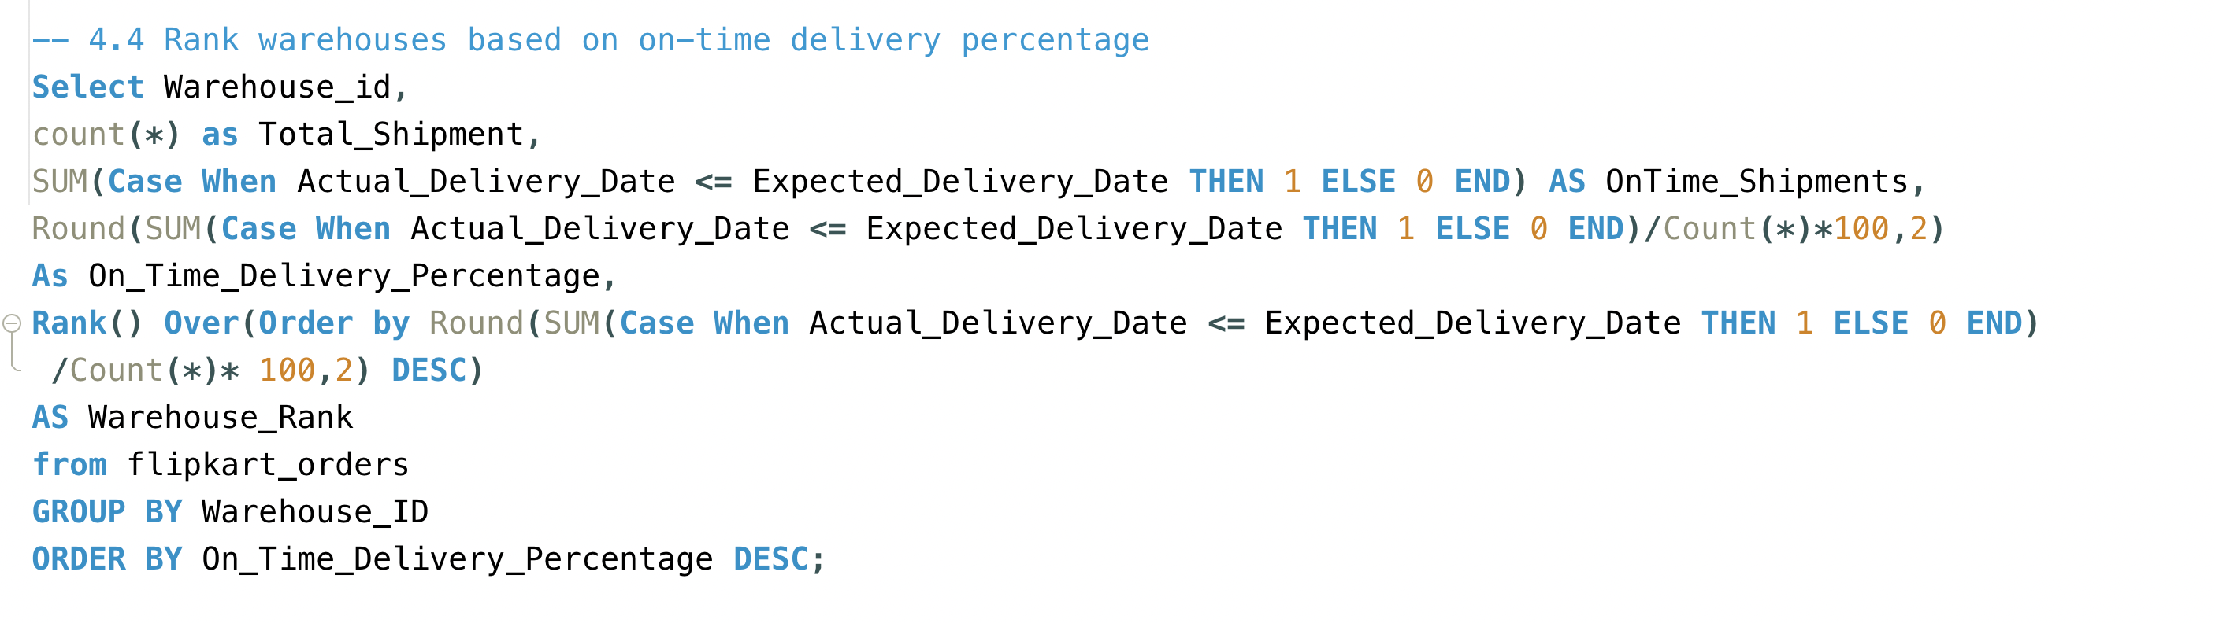
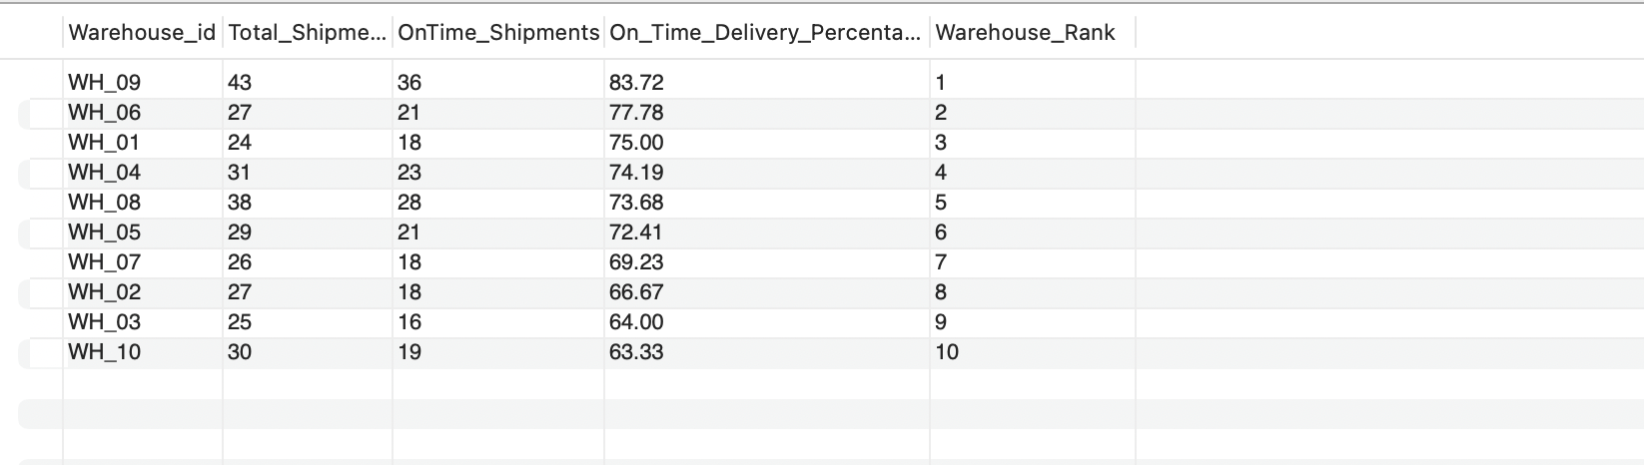
Task 4.4→ Rank warehouses based on on-time delivery percentage

Slide 17
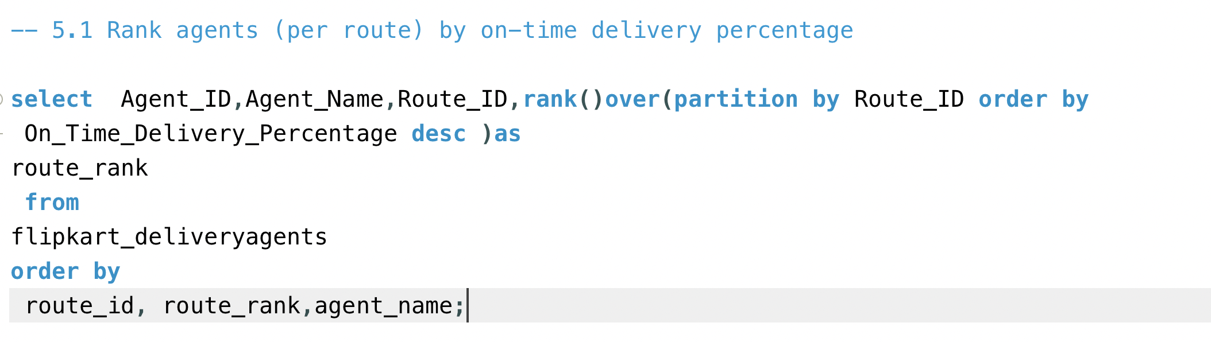
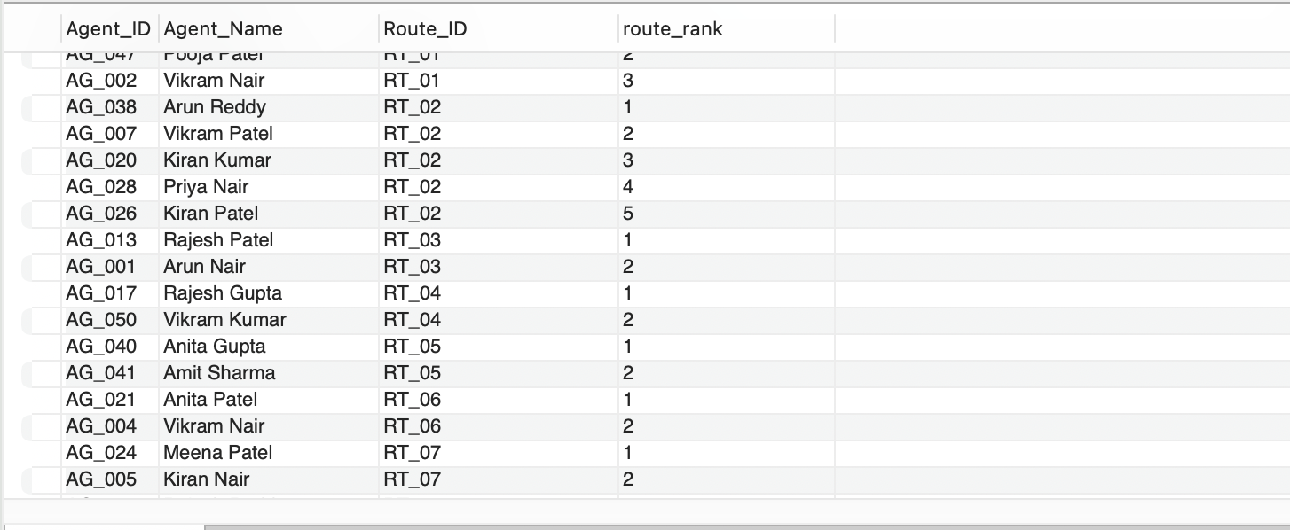
Task 5.1→ Rank agents (per route) by on-time delivery percentage

Slide 18
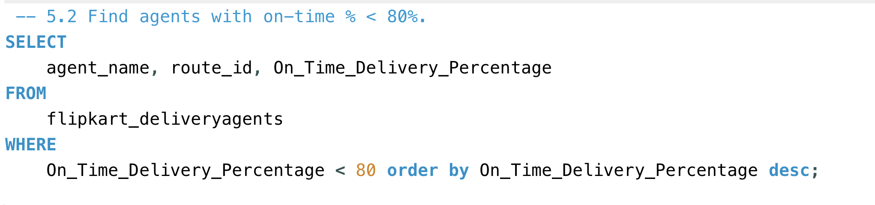
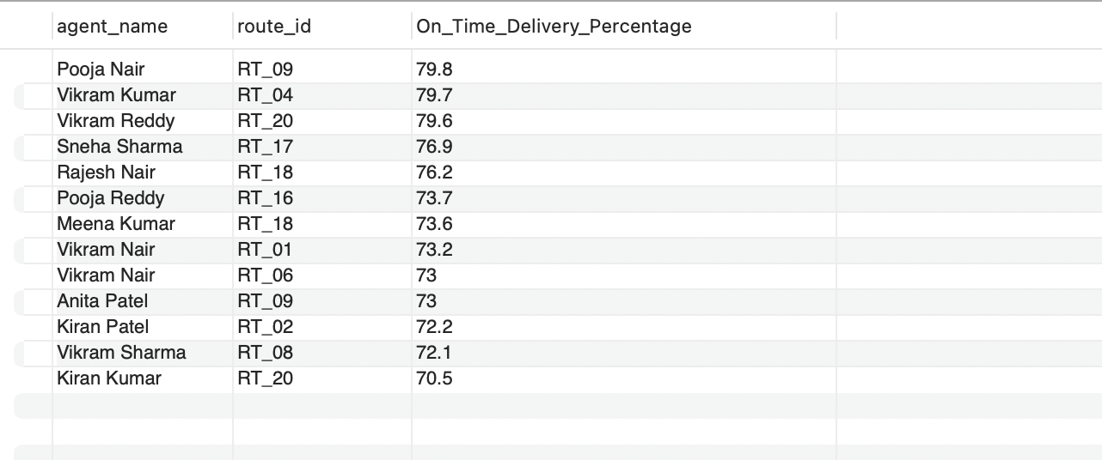
Task 5.2→ Find agents with on-time % < 80%.

Slide 19
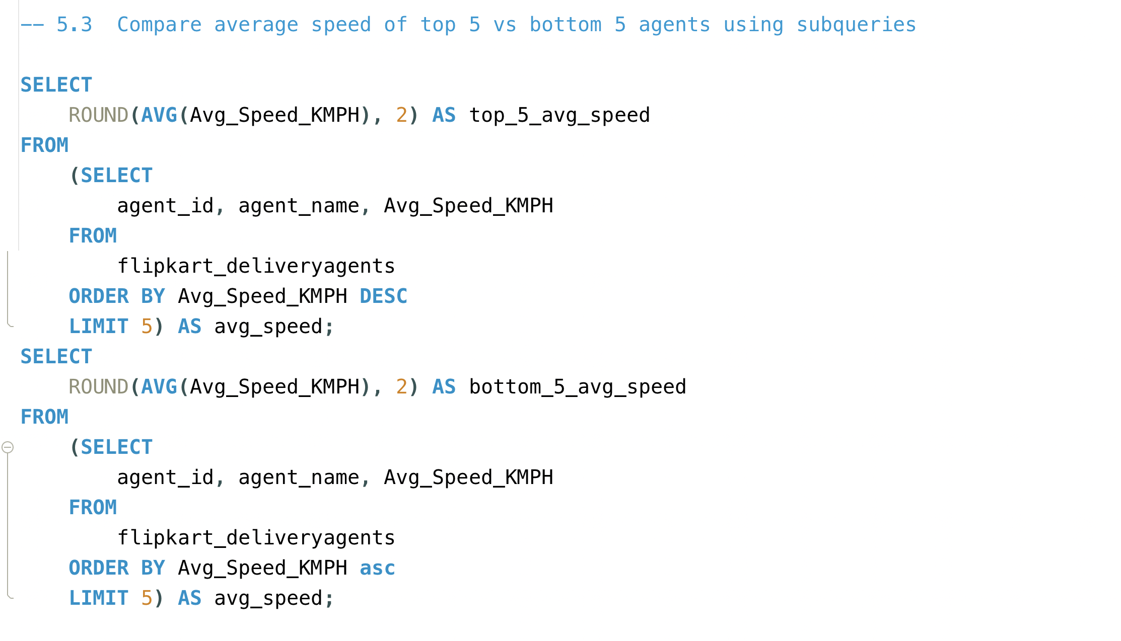
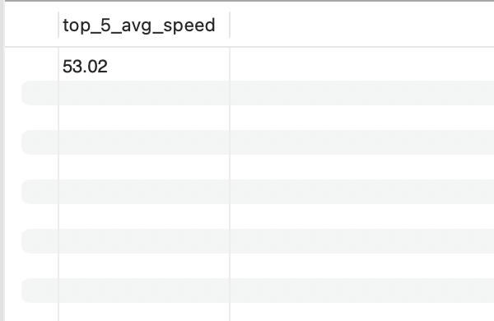
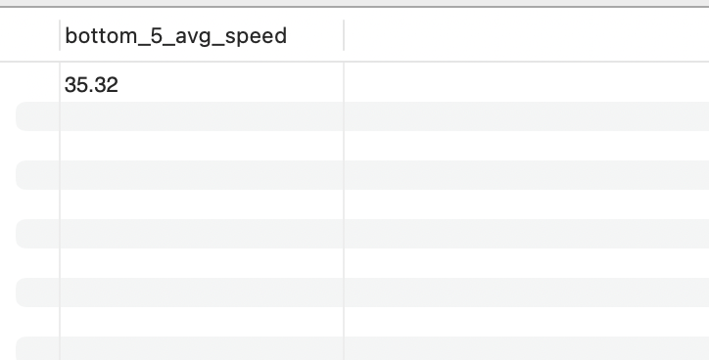
Task 5.3→ Compare average speed of top 5 vs bottom 5 agents using subqueries.
vs

Slide 20
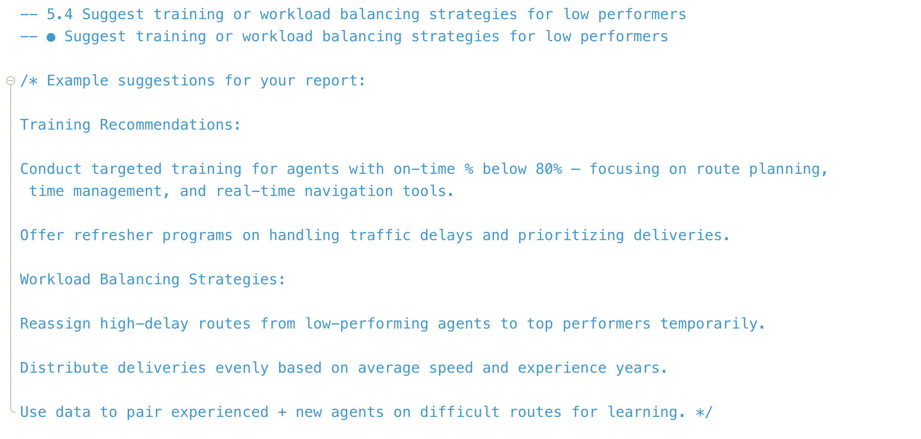
Task 5.4→ Suggest training or workload balancing strategies for low performers

Slide 21
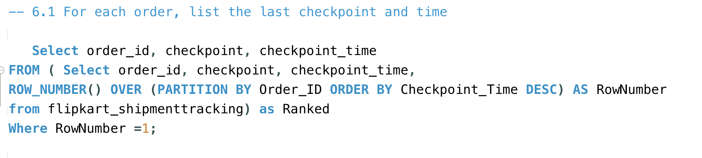
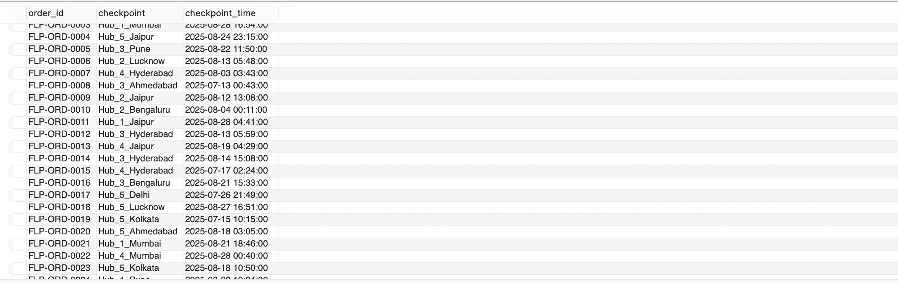
Task 6.1→ For each order, list the last checkpoint and time.

Slide 22
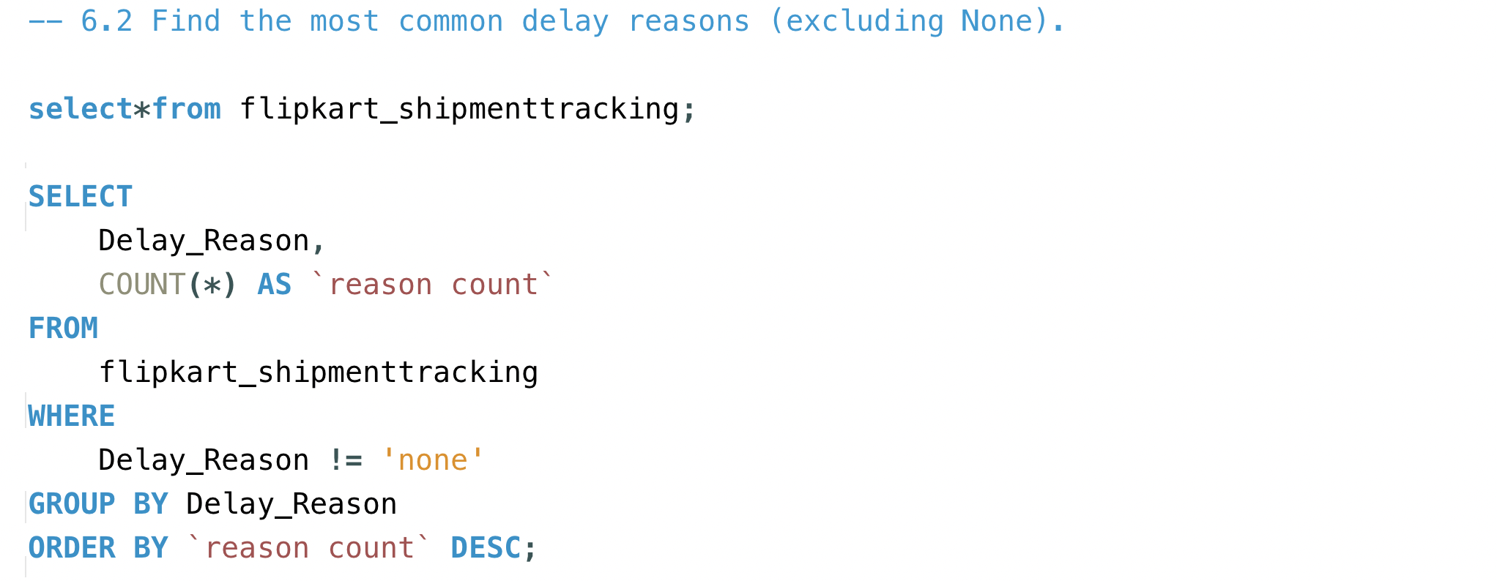
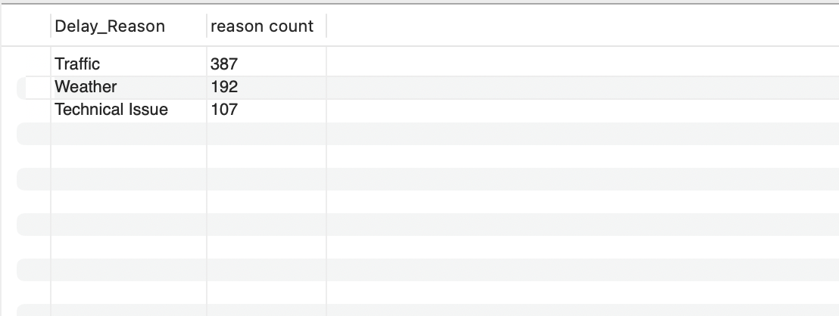
Task 6.2→ Find the most common delay reasons (excluding None).

Slide 23
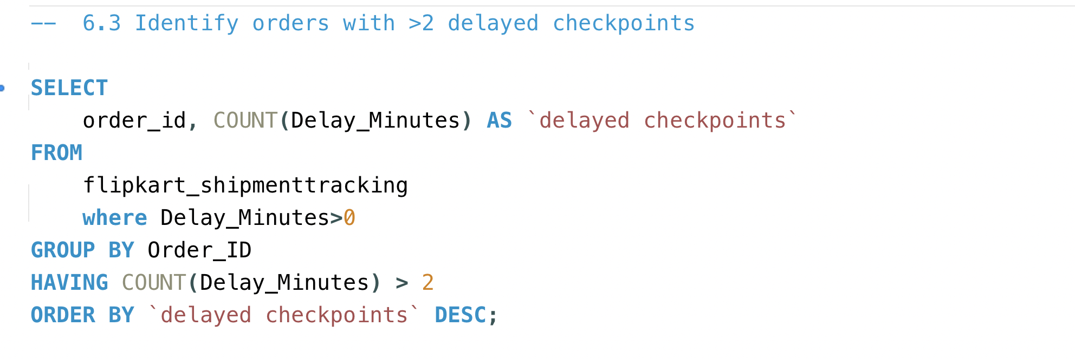
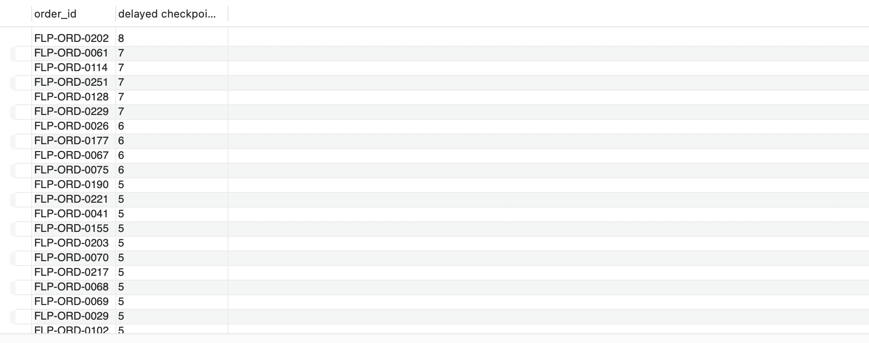
Task 6.3→ Identify orders with >2 delayed checkpoints

Slide 24
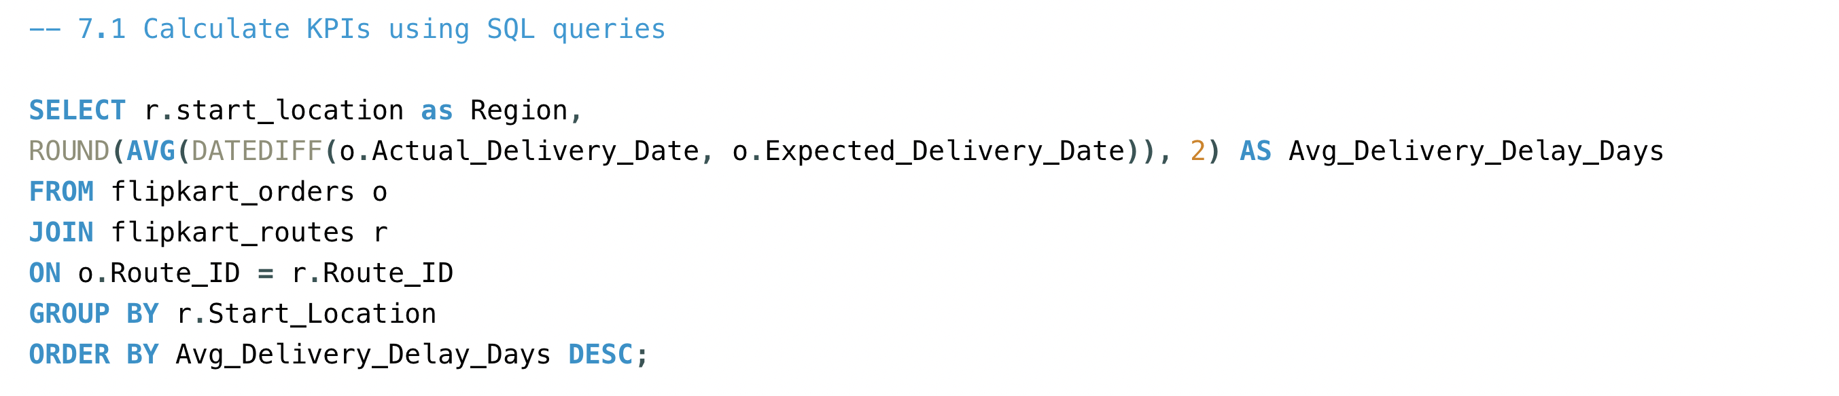
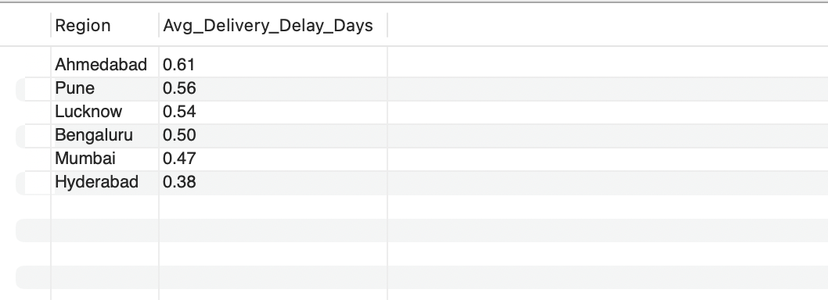
Task 7.1→ Calculate KPIs using SQL queries.

Slide 25
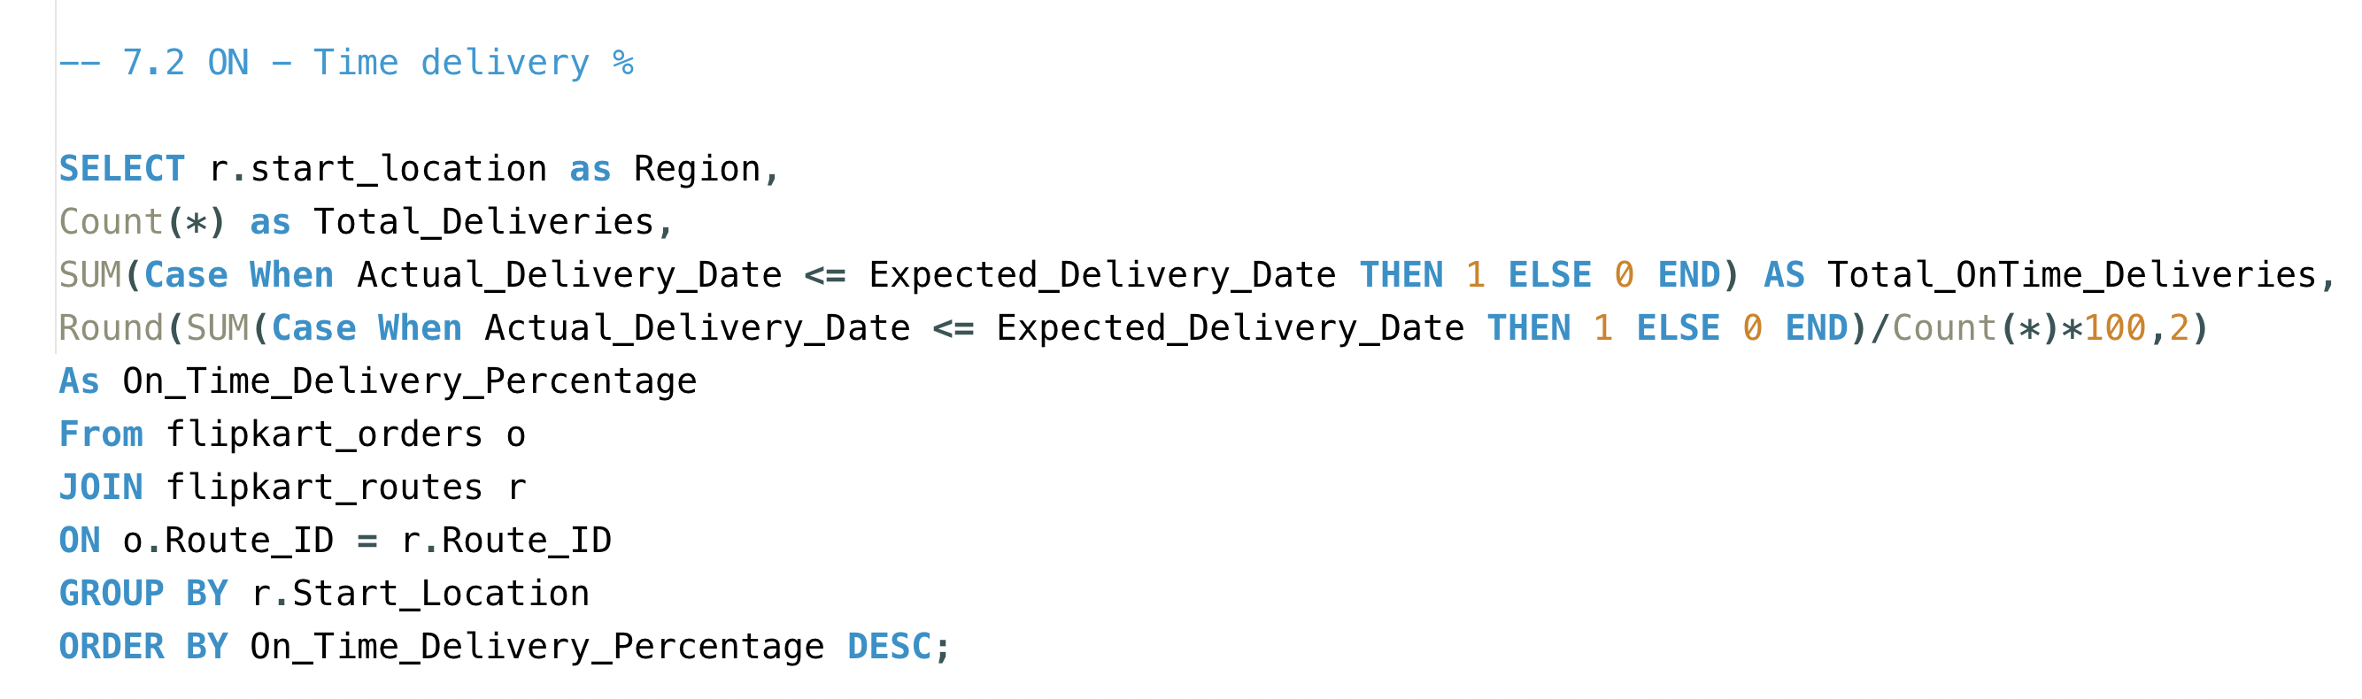
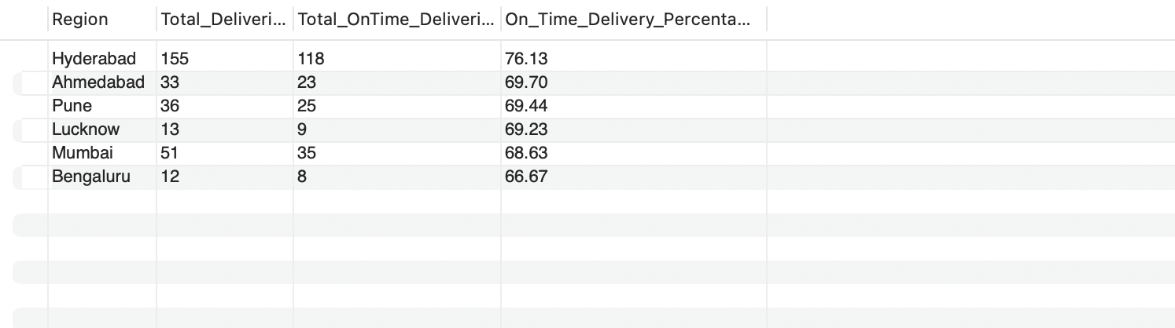
Task 7.2→ On – time delivery

Slide 26
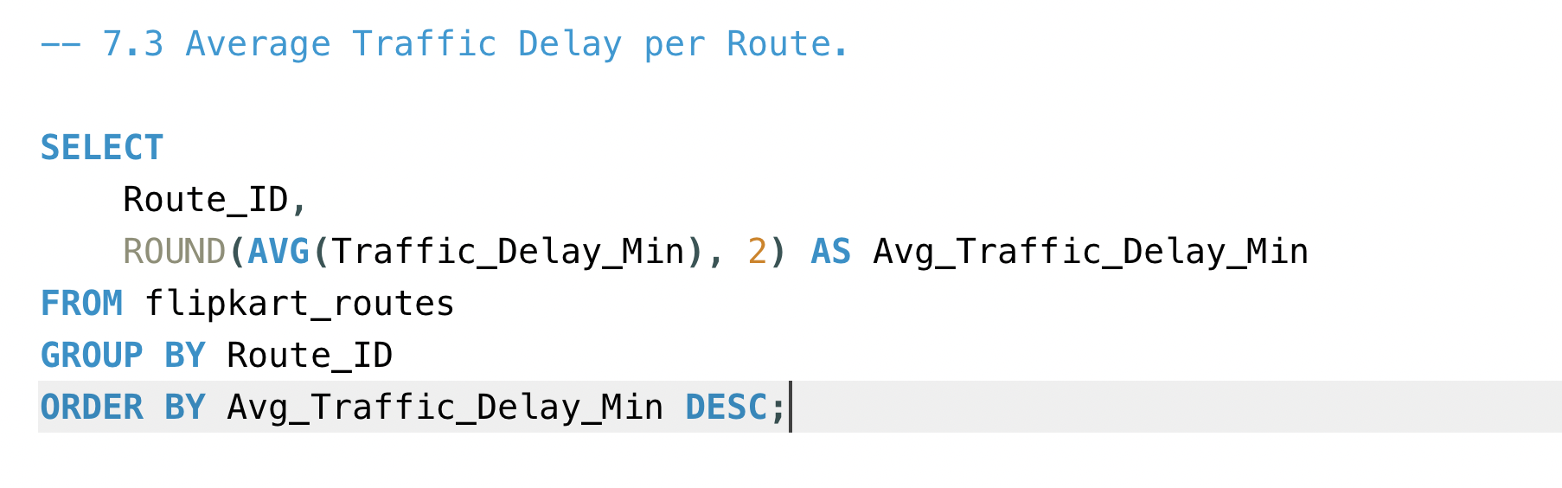

Task 7.3→ Average Traffic Delay Per Route

Slide 27
Task 8→ video submission.
https://www.loom.com/share/890080e10b1d4357b3d94f624bf52362
https://www.loom.com/share/890080e10b1d4357b3d94f624bf52362

